Slide 1
Tilda- Getting started
2019-09-25

Slide 2
Intro
This presentation should allow you to get started with Tilda
Should take 1h to 90mn
Set up your development environment with Java, Eclipse, Tomcat and Postgres
Create a project
Learn the Tilda conventions to get started
Go through a simple yet non-trivial set of example to build an app
Pre-requisits
You need to be somewhat familiar with Java development and a Java IDE
You need some passing experience/familiarity with JSON
You need some passing experience/familiarity with SQL

Slide 3
General architecture
Tilda rests on human-readable and editable JSON-based model definitions that can be edited in any JSON-capable editor and are processed via a variety of command-line utilities:
Gen: validate the model(s), generate ORM code artifacts and searchable/navigatable HTML documentation
Docs: Outputs HTML and SQL documentation to the file system from the model(s)
The ‘T’ in Tilda stands for “Transparent”, and all artifacts are generated in human-readable form, fully commented and documented
Although Tilda allows to model complex data, the framework is architected from the ground up so that all artifacts generated are clear and clean so that the connection between an element in a Tilda definition file and its impact on the runtime or database is easy to see
Generated code relies heavily on the Java compiler to actualize in code many patterns, so that complex migrations (moving tables, changing indices, adding/removing columns etc…) has a direct compile-time impact that can then be easily remedied with standard code editors and refactoring methodologies.
The ‘I’ in Tilda stands for “Iterative”, and all processes and utilities when working with the framework encourage a fluid team-based iterative approach from design to deployment.
Migrate: migrates a database to the model(s)

Slide 4
Development Environment
For this tutorial, we’ll use the following software
Java SE JDK 11.0.3
https://www.techspot.com/downloads/5553-java-jdk.html
Apache Tomcat 9.0.24
http://tomcat.apache.org
Eclipse IDE for Enterprise Java Developers 2019-06 R
https://www.eclipse.org/downloads/packages/
PostgreSQL 11.5
https://www.postgresql.org/
Be aware that
There are no direct dependencies on Tomcat or Eclipse. Any Servlet container or Java IDE will do if you prefer something else.
Java 8 is the minimum requirement, but we like to use the latest and greatest
Postgres 9.6 is the minimum required, but we like to use the latest and greatest.

Slide 5
A Beginner’s Environment

Slide 6
A beginner’s Project
Different organizations have different standards in how they set up their Java-based projects.
We like to set up a base-line project where dependencies and environment configurations are set up and inherited from other projects where application code lives
The application will be composed of a few JARs and a really basic Web application
If you are a seasoned developer, then you might want to skim through this section very quickly to get set up.
This is really targeted at beginners, younger new employees and so on…

Slide 7
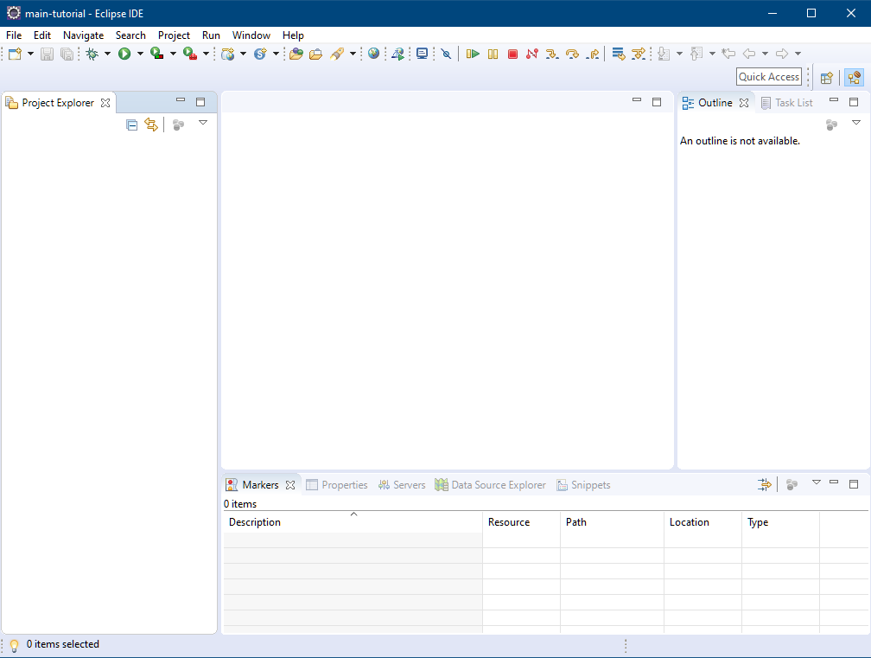
Starting with a clean Workspace
toolbar
perspectives
views

Slide 8
Simple customizations
I have never found a use for the Task List and Outline views.
The “Project Explorer” is nice, but I also like the “Navigator” as it gives you a view of projects that mirrors more closely the actual file system layout.
The “Console” view will be critical for us as we use many command-line utilities
Eclipse supports perspectives where you can customize the views you want. I have found this to not be as useful and like for example to have the “debugger” view in the main perspective
We’ll configure Tomcat and so we also need the “Servers” view.

Slide 9
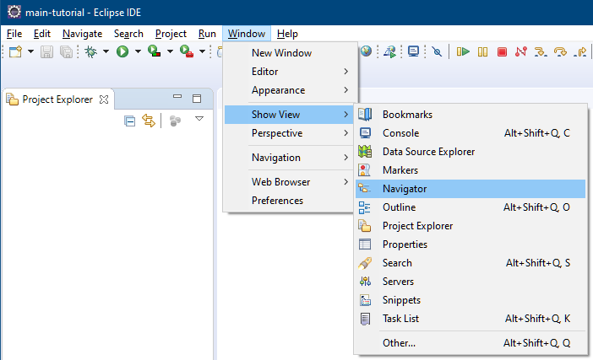
Extra views
You can add new views via the “Window” menu
Select “other…” to find the other views we like
You can then drag and drop your views according to taste

Slide 10
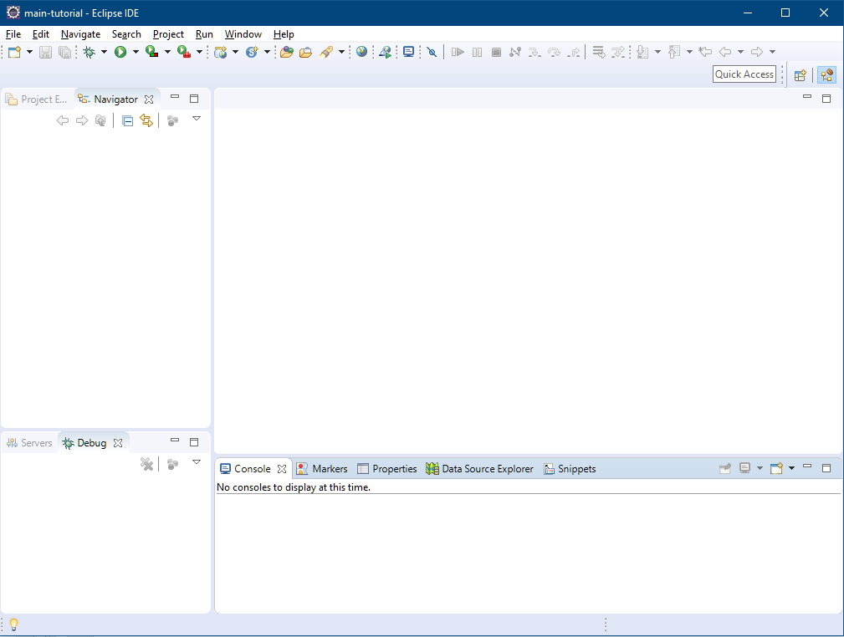
Optimized Perspective (according to someone!)
Project Explorer + Navigator
Main editors…
Servers + Debug
Console and other misc views

Slide 11
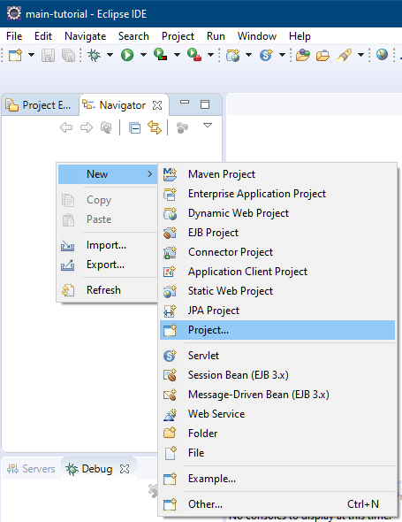
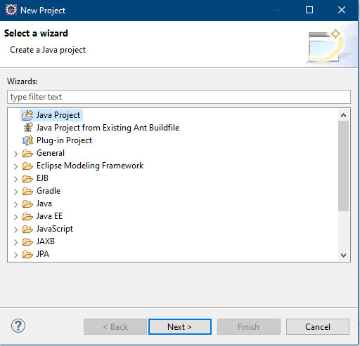
Create a “root” Project
The next few slides show the details of creating a root project.
Right-click in the Navigator.

Slide 12
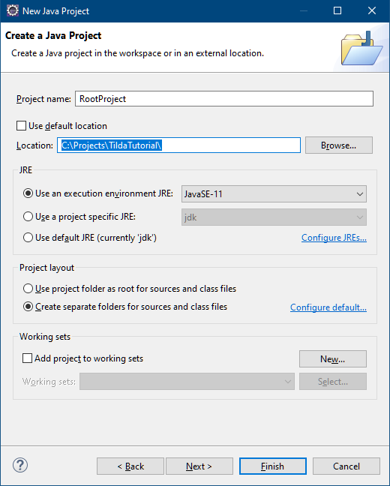
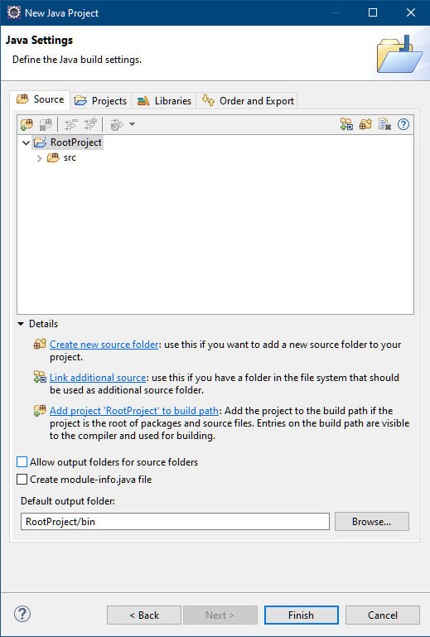
Create a “root” Project
“RootProject” name
C:\Projects\TildaTutorial
Disable the Module file

Slide 13
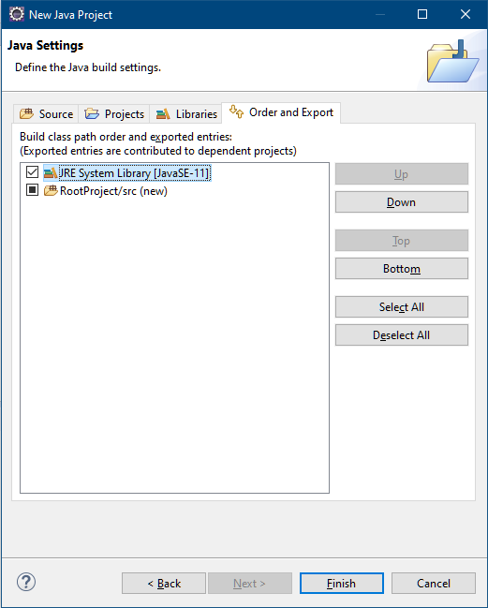
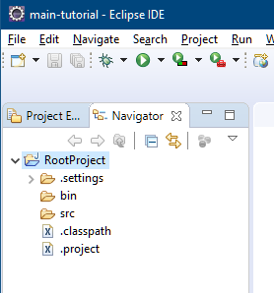
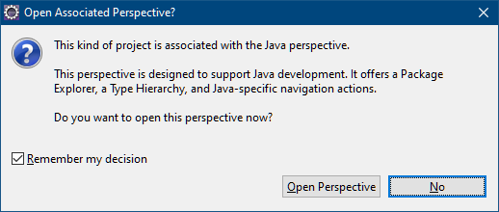
Create a “root” Project
Export the JRE and don’t switch perspective
select or Eclipse will keep bugging you!
choose no!

Slide 14
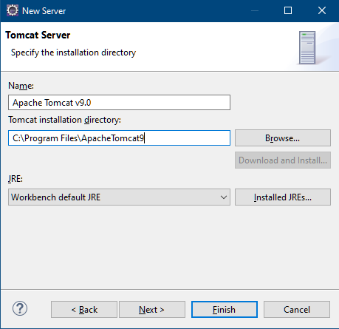
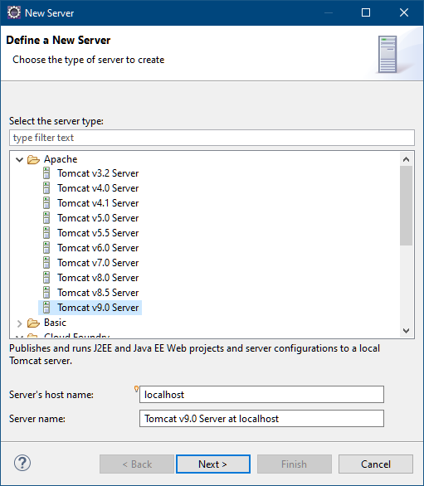
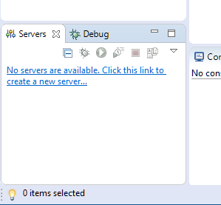
Set up tomcat
On the “Servers” view, add a new server
pick where you installed Tomcat

Slide 15
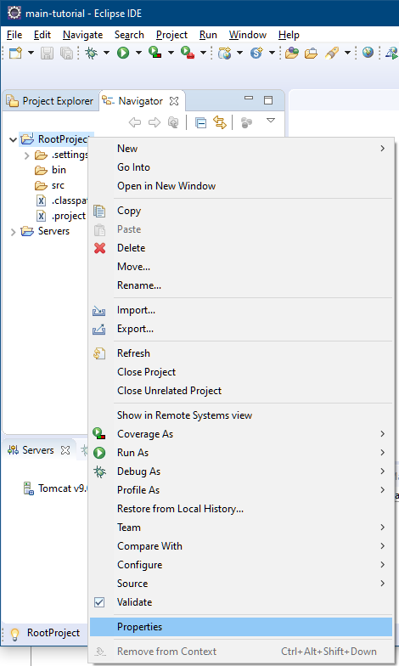
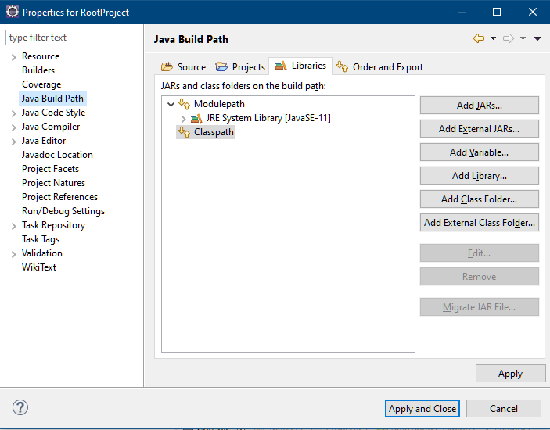
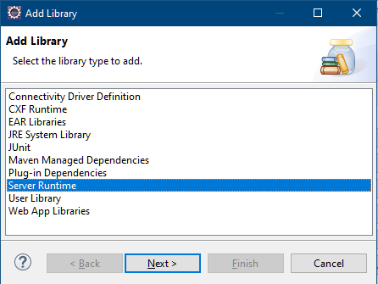
Set up tomcat
Right click on “RootProject” and select “Properties”
“Java Build Path”, “Libraries”, “Add Library”

Slide 16
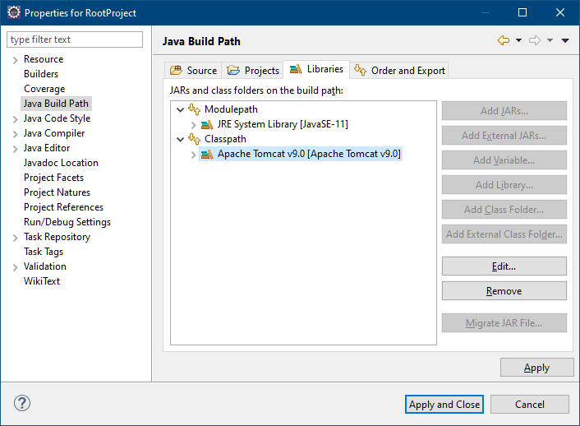
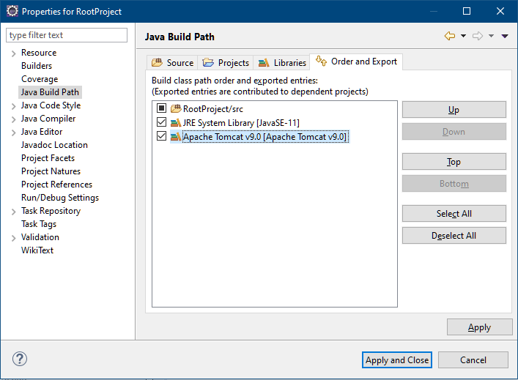
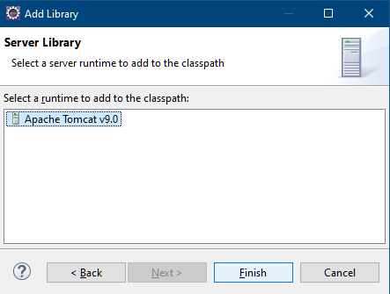
Set up tomcat
Select Tomcat 9
Export
Apply And Close

Slide 17
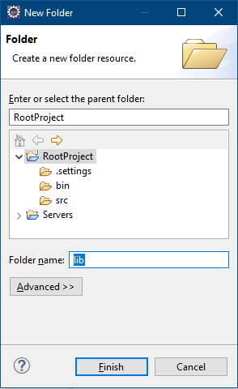
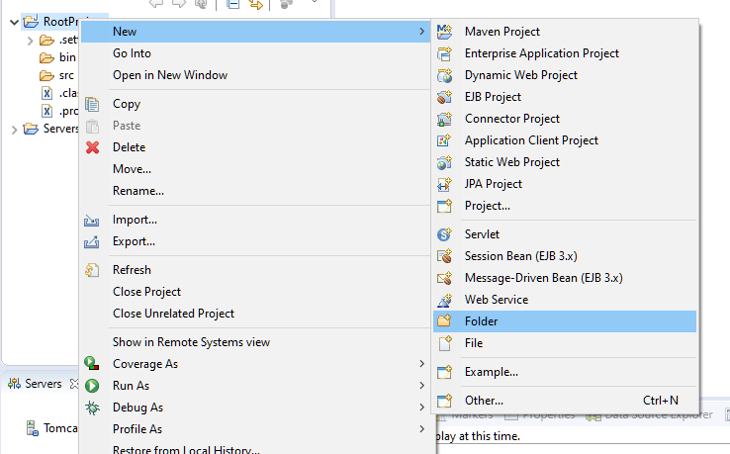
Add the Tilda Libraries
Add a “lib” folder to the project

Slide 18
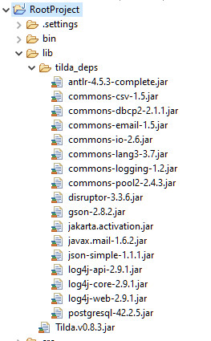
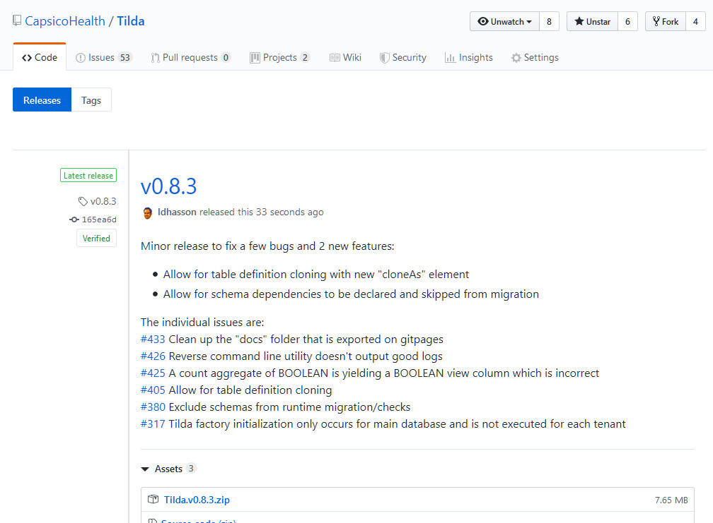
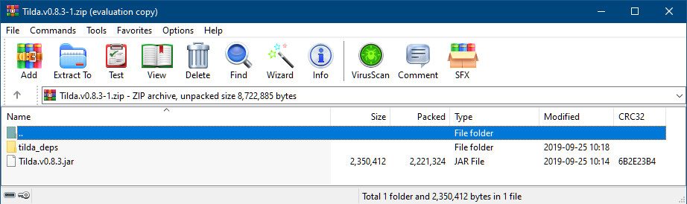
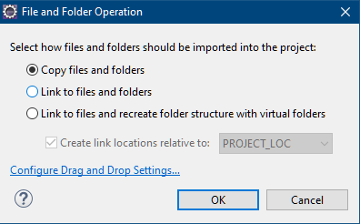
Add the Tilda Libraries
Download the latest Tilda release
https://github.com/CapsicoHealth/Tilda/releases
Drag’n’Drop the contents of the Zip to the “lib” folder

Slide 19
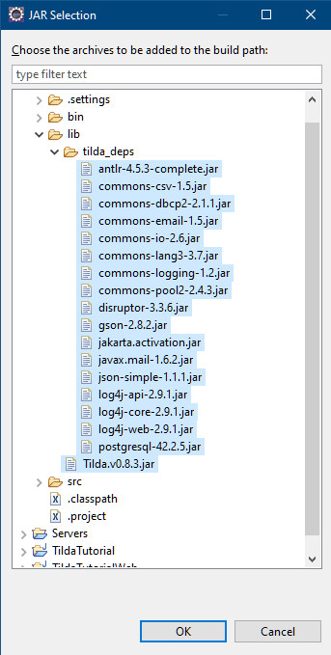
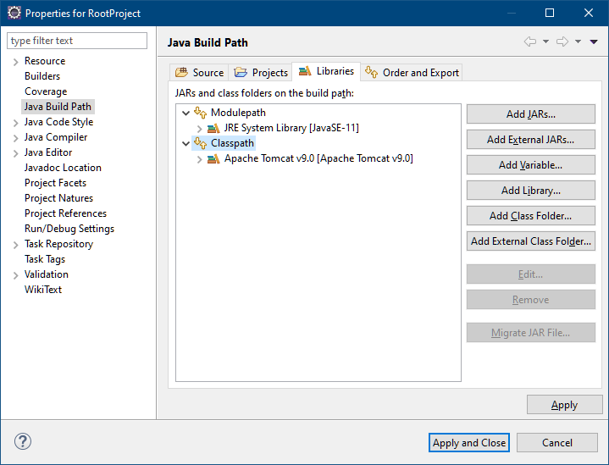
Add the Tilda Libraries
Right click on “RootProject”, select “Properties”, “Java Build Path”
Select “Libraries”, “Add JARs”

Slide 20
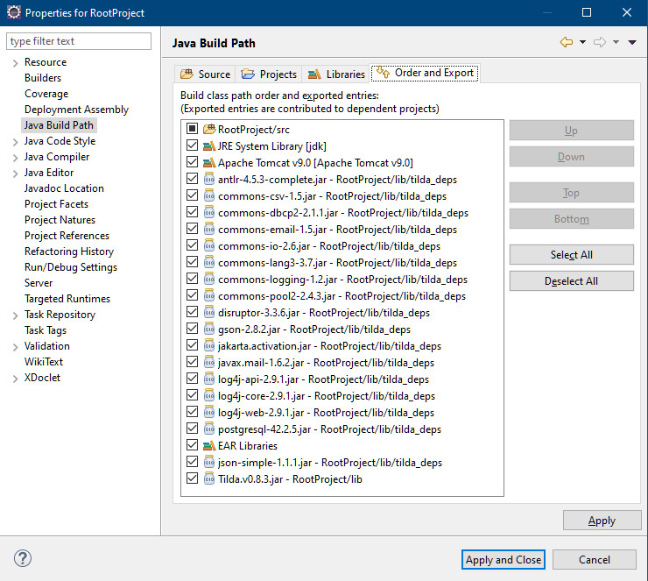
Add the Tilda Libraries
Export all
Apply and close

Slide 21
First Tilda Project

Slide 22
First Tilda Project
In this section, we are going to be creating a bit of infrastructure:
A Java project to hold our Tutorial sample
A Dynamic Web project to serve as our runtime baseline and which we’ll build upon in a follow-up tutorial for Java-based usages of Tilda.
Configuration files log4j2.xml and tilda.config.json
Setting up “Run Configurations” for Gen and Migrate
Skeleton _tilda.TildaTutorial.json file
Running Gen
Creating the TildaTutorial database
Running Migrate
These steps are typically a one-time affair for any new project and take a few minutes to set up.

Slide 23
First Tilda Project
We want to set up a simple relationship hierarchy of projects where in the future:
It’s easy to add new dependencies in the Root project that automatically percolate across the entire project
Each “component” of the tutorial is packaged as a JAR and we can add more in the future
The Web project provides an overall runtime for execution.
Root
Project
Tilda Tutorial Project
Tilda Tutorial Web
Project
Tilda JAR
Dependent JARs
Tutorial “app” logic
Web Runtime

Slide 24
First Tilda Project
Sample files can be found in
https://github.com/CapsicoHealth/Tilda/tree/master/docs/documentation/tutorial_sample_files
Documentation for Gen can be found in
https://github.com/CapsicoHealth/Tilda/wiki/Tilda-Command-Line-Utilities%3A-Gen
Documentation for Migrate can be found in
https://github.com/CapsicoHealth/Tilda/wiki/Tilda-Command-Line-Utilities%3A-Migrate

Slide 25
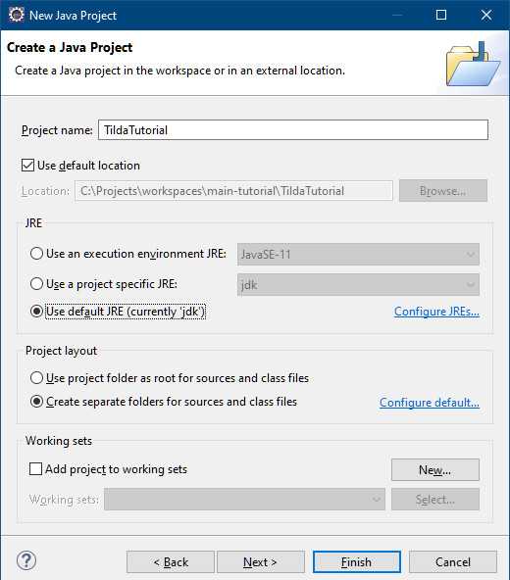
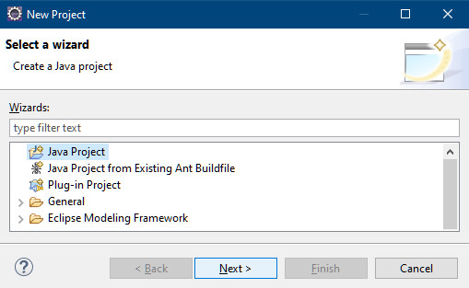
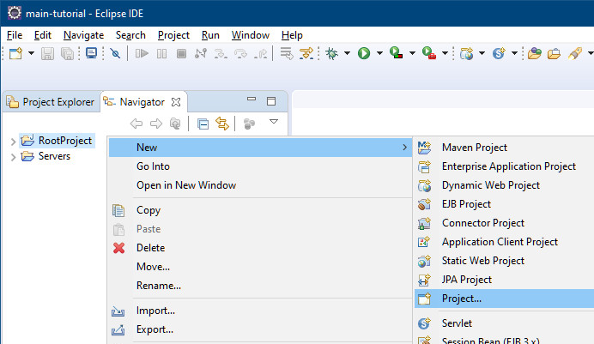
Tutorial Project
Create a new Java project “TildaTutorial”

Slide 26
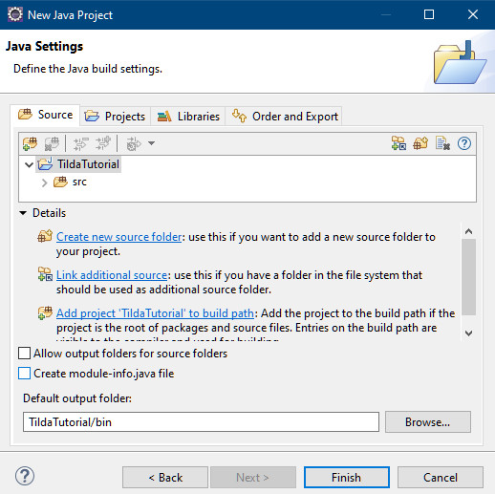
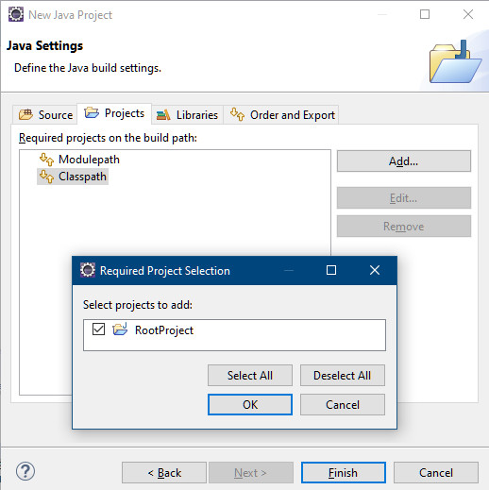
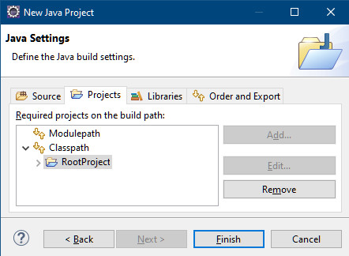
Tutorial Project
Make sure that “module-info.java” is unchecked
In the Projects tab, select “Classpath” and add “RootProject”

Slide 27
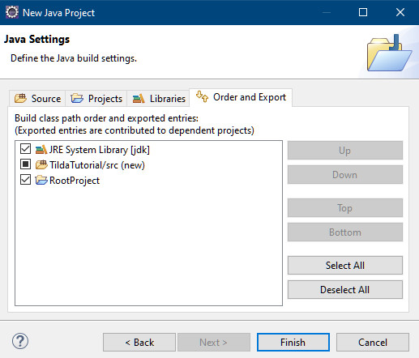
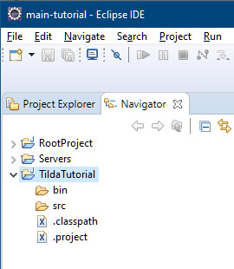
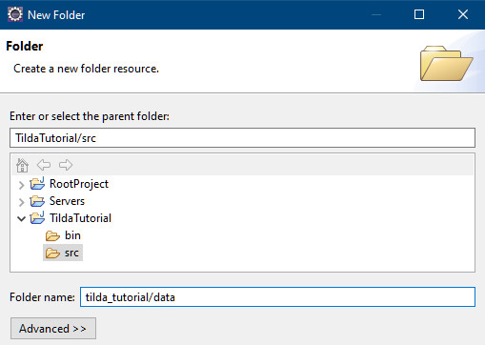
Tutorial Project
In the “Order and Export” tab, make sure all are exported
Then create a folder tilda_tutorial/data

Slide 28
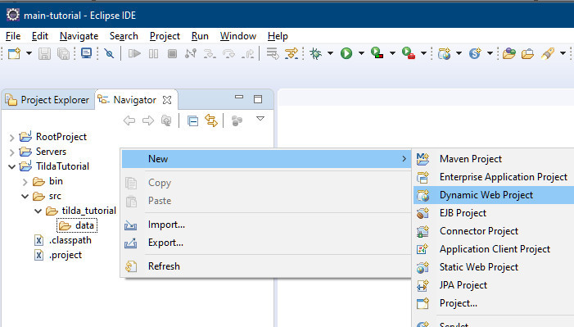
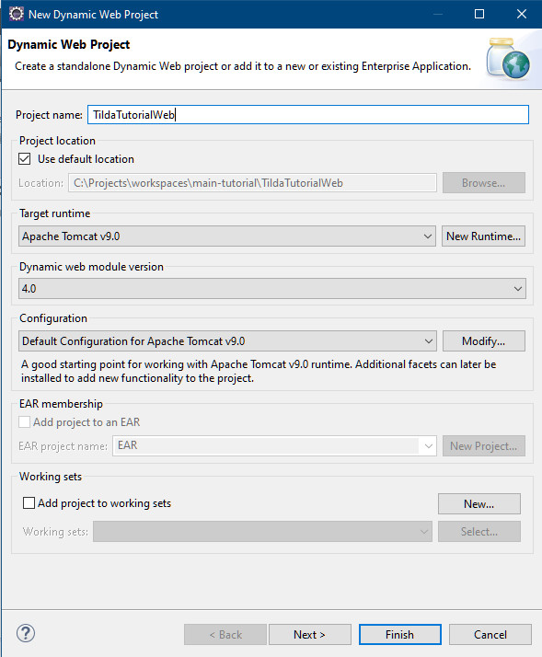
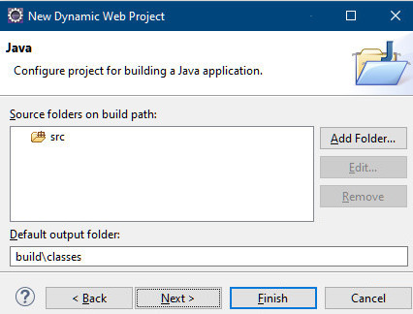
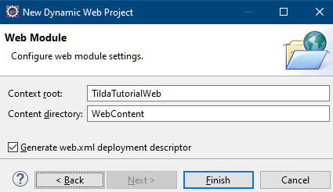
Tutorial Web Project
Create a new Dynamic Web Project “TildaTutorialWeb”
Select “Generate web.xml deployment descriptor”.

Slide 29
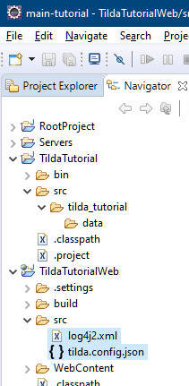
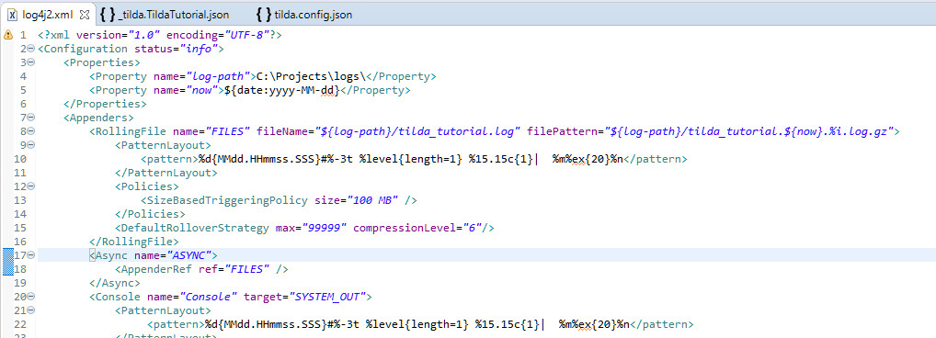
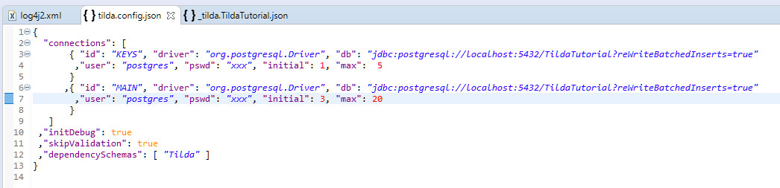
Tutorial Web Project
Copy the files log4j2.xml and tilda.config.json from the sample files folder into your project’s src folder
Configure “log-path” and your database connection details to match your environment

Slide 30
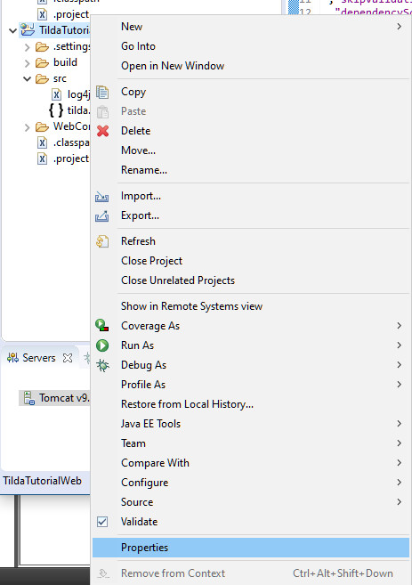
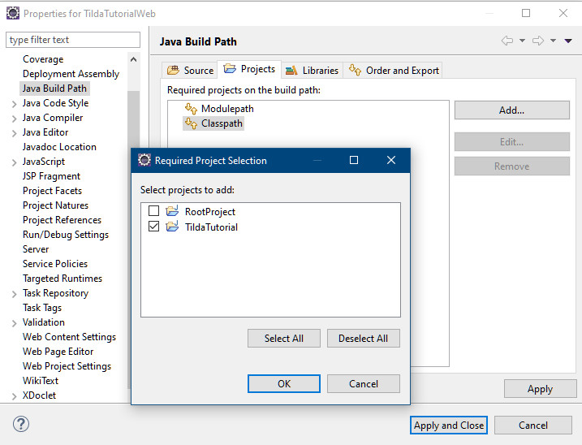
Tutorial Web Project
Configure the project’s java build path properties
Select the “Project” tab and add “TildaTutorial” to the Classpath

Slide 31
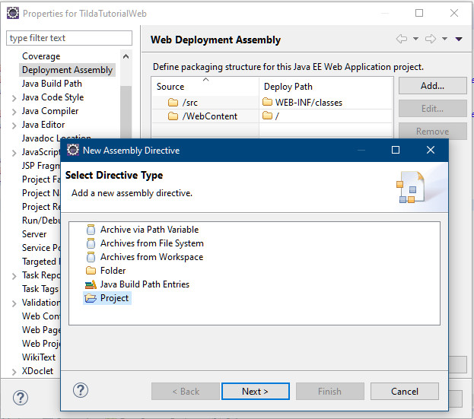
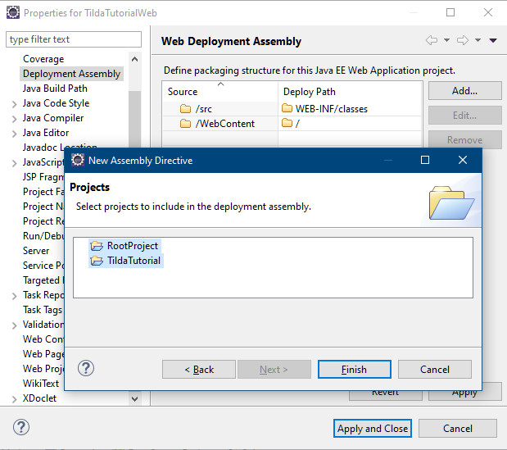
Tutorial Web Project
Configure the Web Deployment Assembly details and add the 2 projects we have created previously.

Slide 32
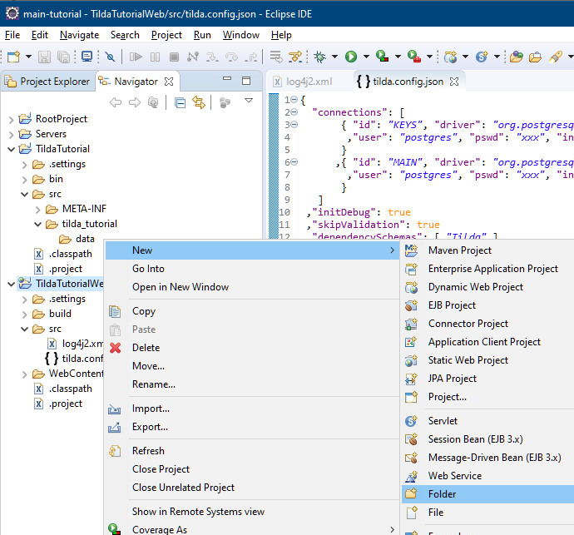
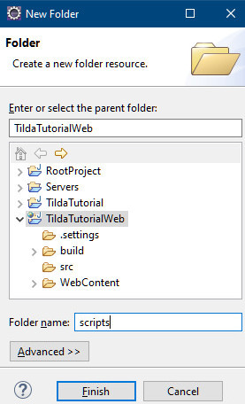


Run Configurations
Create a new folder “scripts” for the run configurations we will create.

Slide 33



Run Configurations
Create a new run configuration for Gen called “Gen Tilda Tutorial”
Project is “TildaTutorialWeb”, main class is “tilda.Gen”, parameters is
${project_loc:TildaTutorial}/src/tilda_tutorial/data/_tilda.TildaTutorial.json
Save to the scripts folder

Slide 34

Run Configurations
If you run “Gen” at this time, you will get an error since we haven’t created the Tilda definition file for the tutorial yet.

Slide 35


Run Configurations
Create a new run configuration for Migrate called “Migrate Tilda Tutorial”
Project is “TildaTutorialWeb”, main class is “tilda.Migrate”, no parameters
Save to the scripts folder

Slide 36

Run Configurations
If you run “Migrate” at this time, the utility will hang because we haven’t created a database yet.

Slide 37

Run Configurations
From now on, the 2 run configurations are available through the shortcuts off the menu

Slide 38


Tilda Definition File
Create your project’s folder structure as “/tilda_tutorial/data”
Copy the file _tilda.TildaTutorial.json from the samples file folder

Slide 39

Tilda Definition File
Run Gen and get a Woohoo!

Slide 40


Tilda Definition File
Once complete, refresh your workspace so generated files are picked up.
Make sure no node is selected in the Navigator. Simply click on any node and then Ctrl-Click it again to unselect it
Right click on a white space in the navigator and select “Refresh”
Every Gen requires a Refresh
You can see a new _Tilda sub-folder has been created with files in there

Slide 41


Tilda Definition File
Create the TildaTutorial database using your favorite DB tool
PGAdmin, Toad, Azure Studio or DBeaver for example.
Here we use DBeaver

Slide 42

Tilda Definition File
Run Migrate

Slide 43

Tilda Definition File
First time we run Migrate, the database is completely empty, so you’ll get some errors that you can ignore.

Slide 44

Tilda Definition File
The utility prompts to start the analysis. Press ‘y’ followed by enter.

Slide 45

Tilda Definition File
For Dev, it’s OK to run with the “postgres” admin account, but the utility flags this as a risk. In prod, you would not use a super user account.

Slide 46

Tilda Definition File
The analysis yields a number of migration steps for your review.
Type “yes” and enter to start the migration proper.
Note how so far we only have an empty schema for the TildaTutorial app.

Slide 47

Tilda Definition File
Migrate also manages the necessary roles for further work

Slide 48

Tilda Definition File
Get a Woohoo!
Check the DB to see the new schemas and tables created.

Slide 49
Conclusion

Slide 50
Ready to play
At this point, you have the infrastructure in place to do your development with Tilda
We have used eclipse here, but any java IDE with the ability to run command-like tools can work.
We have done a Root/Jar/Web configuration of projects, but other configurations and approaches are entirely doable as well: Tilda doesn’t dictate any of this.
Some people use notepad++ and the command line for their work
You can use whatever DB tool you like to work against the database.
There are two tutorials which build on this “getting started” guide in the Wiki.
https://github.com/CapsicoHealth/Tilda/wiki/First-Tutorial-Part-1%3A-Benefits-Of-A-Transparent-Iterative-Model-Driven-Approach
https://github.com/CapsicoHealth/Tilda/wiki/WebDev-Tutorial-Part-1%3A-Easy-Servlets

